Slide 1

MICROSOFT MOVIE ANALYSIS
Assisting Microsoft to invest money in movie industry

Slide 2

SUMMARY
I have been tasked with assisting Microsoft company to invest money in the movie industry. My goal was to explore what types of films are doing the best at the box office and provide these findings to Microsoft executives.
My analysis of the movie industry achieved by gathering data and utilizing descriptive statistics and visualizations has shown that a larger budget is correlated with a higher worldwide box office gross.
By allocating 15-35 million dollars budget to produce a live-action superhero movie and release it in April or May. Moreover, by allocating 12-35 million dollars in the budget to produce an animated musical movie and release it in June or November. Microsoft can use this report to target their production budget, genre, type, release time of their upcoming movie and also the crew members as well to generate the highest amount of revenue possible.
Here I am going to mention the outline in below slides

Slide 3

BUSINESS PROBLEM
Every business should face problems at the time of entering into the market. Here Microsoft as well will face some issues during the initial stage. To overcome those, I have been informed that Microsoft wants a piece of information about the multi-billion-dollar movie-making industry, but they are unsure where to begin. However, they are ready to jump into the industry but do not have the necessary knowledge to move forward.
Here are the Four Factors that should be looked at
Movie type(genres)
Release month
Movie Overall Budget
Pulse of the audience by analyzing the trend from the last 8-10 years

Slide 4

The Method
I utilized descriptive statistics as well as visualizations to illuminate trends in the data and isolate key factors for making a successful movie

Slide 5

Data Sets
We have chosen 3 different csv file data sets to conclude which genre doing good and in how much range the budget stick
Imdb.title.basics.csv.gz(to give an idea about the which genres doing good in the market )
Imdb.title.ratings.csv.gz(better to understand the movie ratings)
tn.movie_budgets.csv.gz(better to give an idea how much budget need to allocate for a movie)

Slide 6
Movie Type
Here we need to analyze what kind of movies are currently most successful!!!!
We are analyzing the genres, creative type and production method to get to know what type of movie genres get more success in the box office

Slide 7
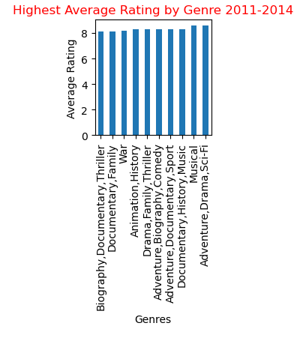
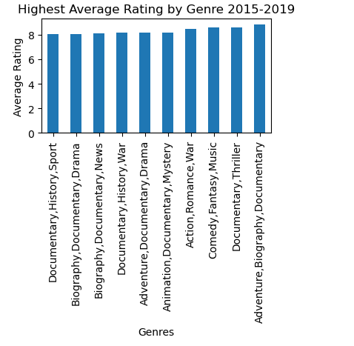
Analyzing highest rating genres

Slide 8
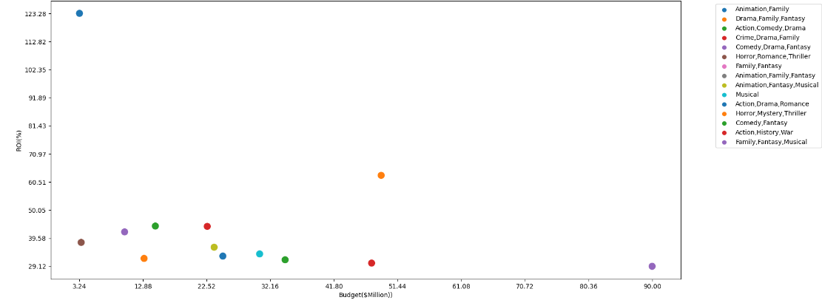
BUDGET ALLOCATION AND ROI

Slide 9
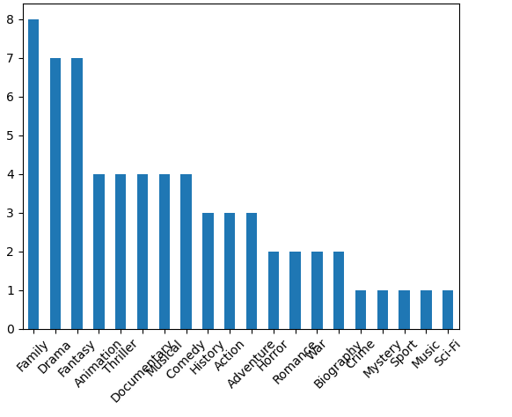
HIGHEST GENRES

Slide 10

CONCLUSION
In conclusion, I would recommend that Microsoft release one of the following two movies each with two specific
recommendations that have proven to be successful combinations:
Option 1
Live action super hero movie with a production budget of 15– 35 million dollars, which would be ideal release in
the month of December
Option 2
Animated musical or fantasy movie with a production budget of 20 – 35 million dollars, which would be ideal to release in
the month of April or May.

